Slide 1
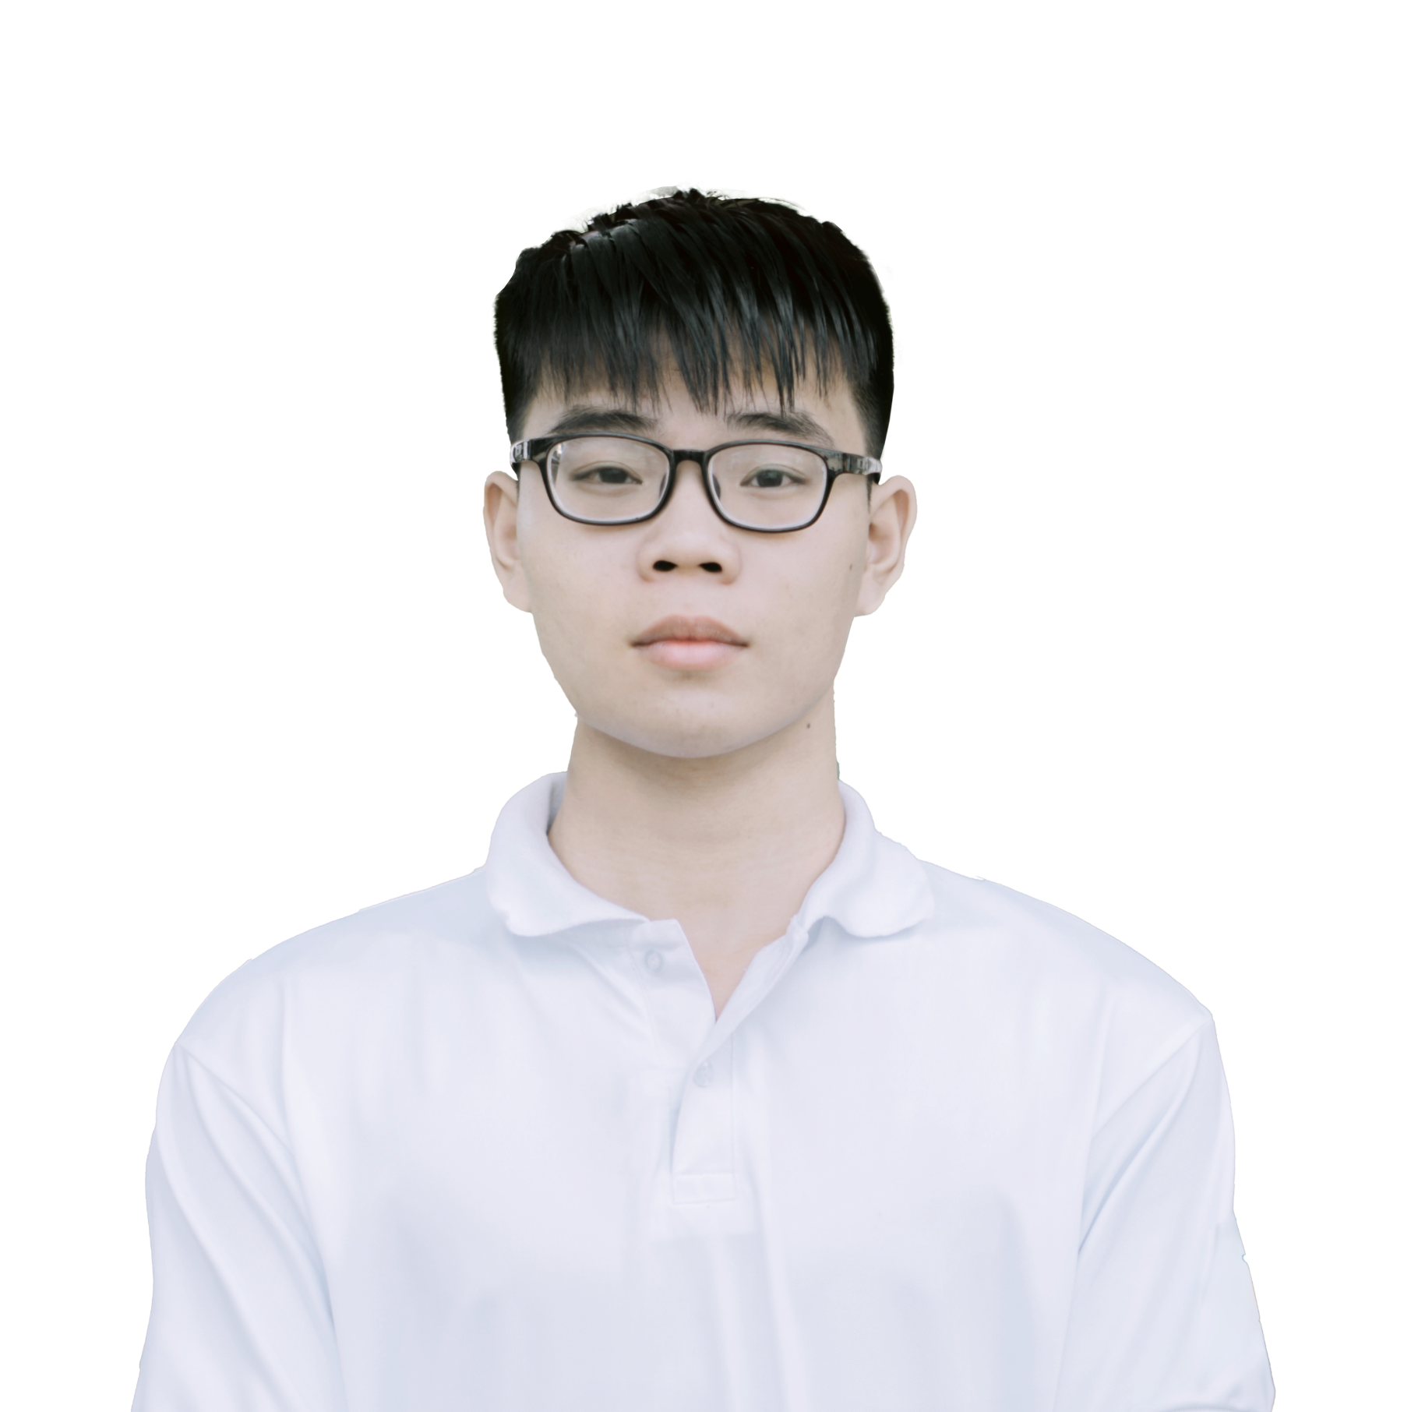















x
NGUYEN DANG LOC
Software engineer
I am a self-motivated and intensely passionate software engineering student with 4 years of experience in programming. I’m creative, open-minded and desire to be a multi-tasker. I believe that my fast learning abilities, dedication to achieve and several awards in relevant fields make me best candidate for this role.
About Me
Objectives
Male
Gaining knowledge, improving competencies in marketing, product and strategy, which would be incredibly beneficial to my career path
Experience in a valuable competition environment for the chance to learn and grow
January 17, 2002
District 9, HCM City, Vietnam
Experiences
Contact
2021 Apr - Present
Smart Agri - Project Manager
(+84) 0357 543 620
Main responsibilities:
Planning, executing and monitoring the deployment process of a app
Leading other 4 team members
Recognition & gains:
High marks and favorable feedbacks from course lecturer
Deeper understanding of an app development process
locnd.fpt@gmail.com
linkedin.com/locnd283
Mar 2020 – Sep 2020
Computerholic Community - Member of Technical Team
Education
Main responsibilities:
Built, managed a web platform for sharing knowledge, connecting IT students
Recognition & gains:
Achieved more than 500 users on the platform, over 5000 fanpage followers
Sep 2020 - Present
FPT University (HCM City)
BEng in Software Engineering
Aug 2017 Aug – Dec 2019
Aug 2017 – Aug 2020
High School – Member of Gifted Team in IT
Quang Trung High School
for the Gifted, Binh Phuoc
Main responsibilities:
Participated in competitive programming contests
Recognition & gains:
Fundamental knowledge of informatics to prepare for higher development
Developed a personal coding style and major mindset
Mathematics major (GPA: 3.6/4)
Honors & Awards
Skills
Sep 2020
Programming languages
Full ride scholarship
C/C++
Excellent
FPT University
Java
Good
Apr 2019
Python
Good
Sliver medal
HTML/CSS, JavaScript
Good
Vietnam Southern Provincial Olympiad 30/4 in Informatics
Languages
Dec 2019
Vietnam (mother-tongue)
Second prize
English (Good)
Informatics Olympiad for High school student
Others
Interests
Designing, editing
Excellent
PTS, AI, PR, AE
Photography, Film-making,
Travelling, Swimming
Microsoft Office
Good
Words, Excel, Powerpoint,…

